Slide 1


Introduction to BlockChain and CryptoCurrency
Introduction to Cryptocurrency and Bitcoin

Slide 2
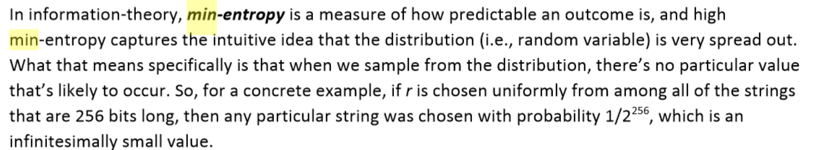
Hash property 3: Puzzle-friendly
Puzzle-friendly:
For every possible output value y,
if k is chosen from a distribution with high min-entropy,
then it is infeasible to find x such that H(k | x) = y.

Slide 3
Application: Search puzzle
Given a “puzzle ID” id (from high min-entropy distrib.),
and a target set Y:
Try to find a “solution” x such that
H(id | x) ∈ Y.
Puzzle-friendly property implies that no solving strategy is much better than trying random values of x.

Slide 4
Hash Pointers and Data Structures

Slide 5
hash pointer is:
* pointer to where some info is stored, and
* (cryptographic) hash of the info
if we have a hash pointer, we can
* ask to get the info back, and
* verify that it hasn’t changed

Slide 6
H( )
(data)
will draw hash pointers like this

Slide 7
Build data structures with hash pointers

Slide 8
linked list with hash pointers = “block chain”
H( )
prev: H( )
prev: H( )
prev: H( )
data
data
data
use case: tamper-evident log

Slide 9
detecting tampering
H( )
prev: H( )
prev: H( )
prev: H( )
data
data
data
use case: tamper-evident log

Slide 10
binary tree with hash pointers = “Merkle tree”
H( ) H( )
H( ) H( )
H( ) H( )
H( ) H( )
H( ) H( )
H( ) H( )
H( ) H( )
(data)
(data)
(data)
(data)
(data)
(data)
(data)
(data)

Slide 11
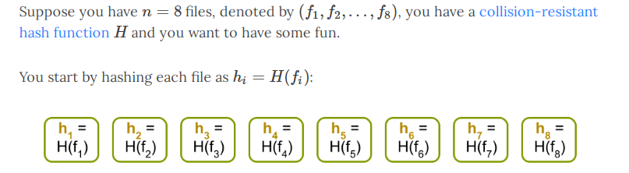
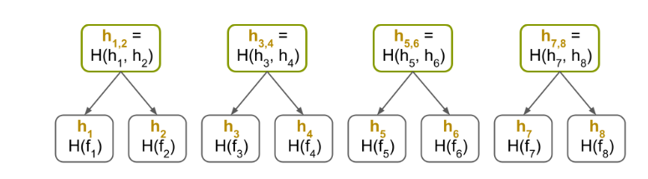

Slide 12
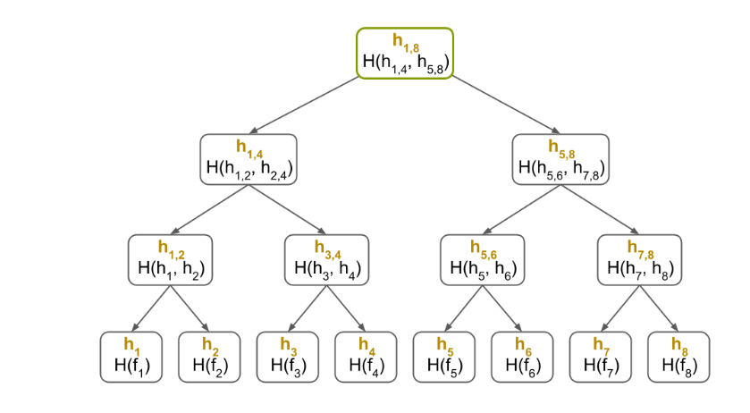

Slide 13
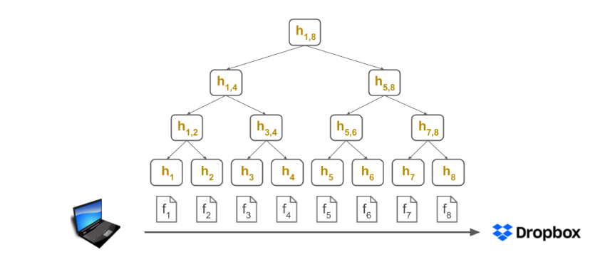

Slide 14
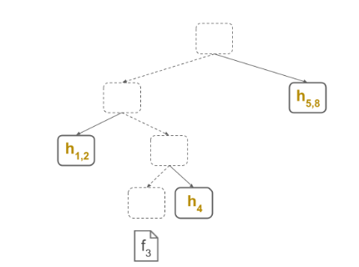

Slide 15
proving membership in a Merkle tree
show O(log n) items
H( ) H( )
H( ) H( )
H( ) H( )
(data)

Slide 16
Advantages of Merkle trees
Tree holds many items
but just need to remember the root hash
Can verify membership in O(log n) time/space
Variant: sorted Merkle tree
can verify non-membership in O(log n)
(show items before, after the missing one)

Slide 17
Simple Cryptocurrencies

Slide 18

GoofyCoin

Slide 19
Goofy can create new coins
New coins belong to me.
signed by pk_{Goofy}
CreateCoin [uniqueCoinID]

Slide 20
A coin’s owner can spend it.
Alice owns it now.
signed by pk_{Goofy}
Pay to pk_{Alice} : H( )
signed by pk_{Goofy}
CreateCoin [uniqueCoinID]

Slide 21

The recipient can pass on the coin again.
signed by pk_{Alice}
Bob owns it now.
Pay to pk_{Bob} : H( )
signed by pk_{Goofy}
Pay to pk_{Alice} : H( )
signed by pk_{Goofy}
CreateCoin [uniqueCoinID]

Slide 22
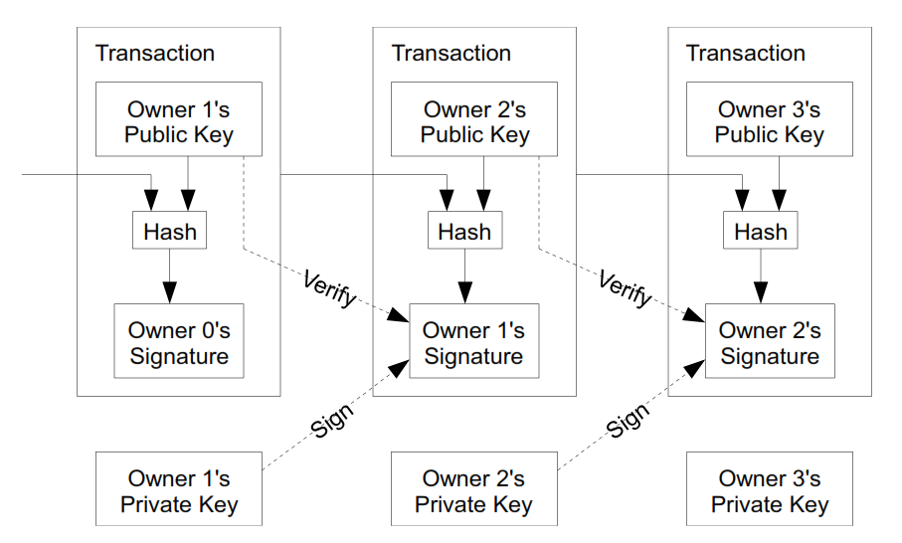

Slide 23
double-spending attack
signed by pk_{Alice}
signed by pk_{Alice}
Pay to pk_{Bob} : H( )
Pay to pk_{Chuck} : H( )
signed by pk_{Goofy}
Pay to pk_{Alice} : H( )
signed by pk_{Goofy}
CreateCoin [uniqueCoinID]

Slide 24
double-spending attack
the main design challenge in digital currency

Slide 25

ScroogeCoin

Slide 26

Scrooge publishes a history of all transactions
(a block chain, signed by Scrooge)
H( )
prev: H( )
prev: H( )
prev: H( )
transID: 71
transID: 72
transID: 73
trans
trans
trans
optimization: put multiple transactions in the same block

Slide 27
CreateCoins transaction creates new coins
Valid, because I said so.
transID: 73 type:CreateCoins
coins created
num | value | recipient
0 | 3.2 | 0x...
1 | 1.4 | 0x...
2 | 7.1 | 0x...
coinID 73(0)
coinID 73(1)
coinID 73(2)

Slide 28
PayCoins transaction consumes (and destroys) some coins,
and creates new coins of the same total value
transID: 73 type:PayCoins
consumed coinIDs:
68(1), 42(0), 72(3)
Valid if:
-- consumed coins valid,
-- not already consumed,
-- total value out = total value in, and
-- signed by owners of all consumed coins
coins created
num | value | recipient
0 | 3.2 | 0x...
1 | 1.4 | 0x...
2 | 7.1 | 0x...
signatures

Slide 29
Immutable coins
Coins can’t be transferred, subdivided, or combined.
But: you can get the same effect by using transactions
to subdivide: create new trans
consume your coin
pay out two new coins to yourself

Slide 30
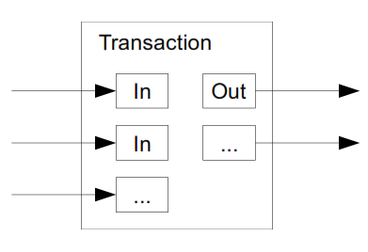

Slide 31
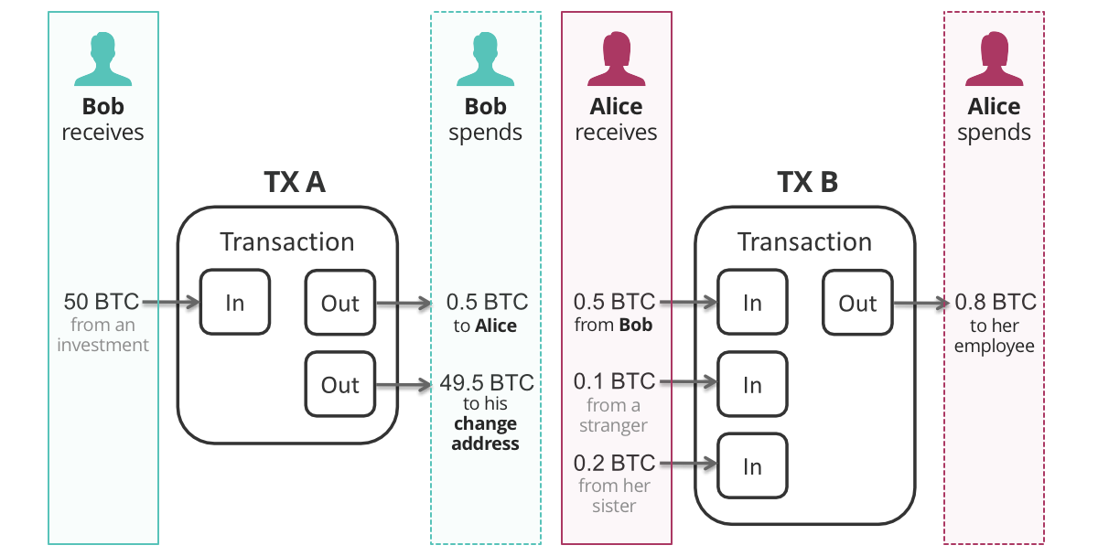

Slide 32
Don’t worry, I’m honest.
Crucial question:
Can we descroogify the currency, and operate without any central, trusted party?

Slide 33
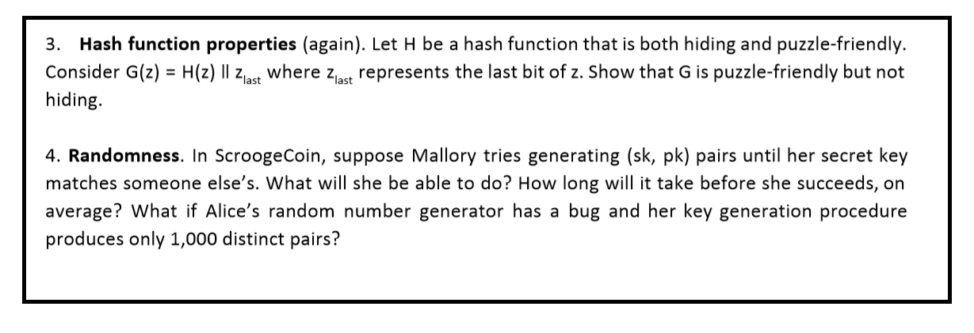

Slide 34
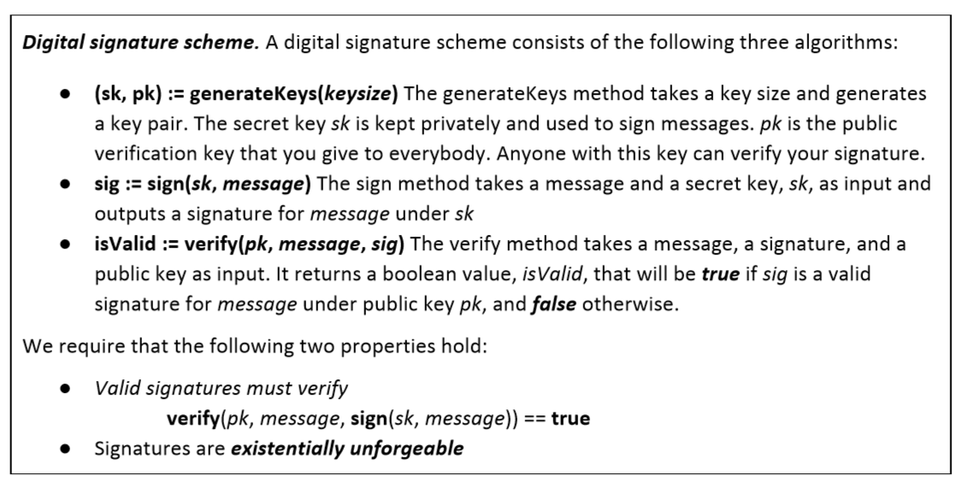

Slide 35
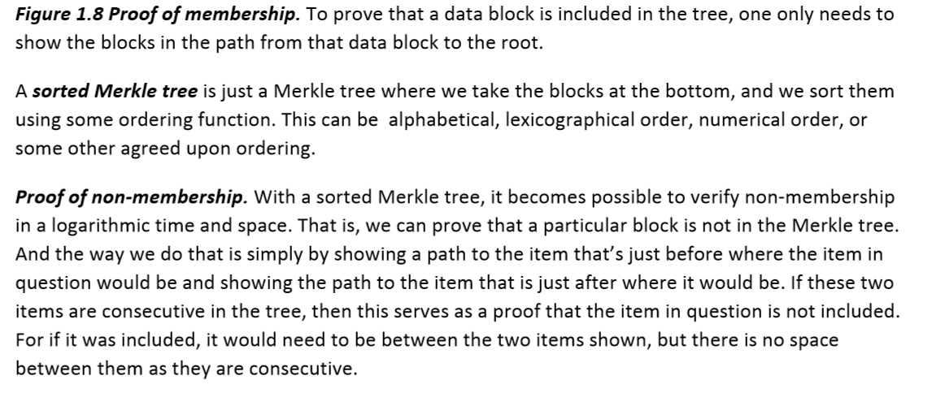

Slide 36
Start Of
Chapter 2: How Bitcoin Achieves Decentralization

Slide 37
How Bitcoin Achieves Decentralization

Slide 38
Aspects of decentralization in Bitcoin
Who maintains the ledger?
Who has authority over which transactions are valid?
Who creates new bitcoins?
Who determines how the rules of the system change?
How do bitcoins acquire exchange value?
Beyond the protocol:
exchanges, wallet software, service providers...

Slide 39
Aspects of decentralization in Bitcoin
Peer-to-peer network:
open to anyone, low barrier to entry
Mining:
open to anyone, but inevitable concentration of power
often seen as undesirable
Updates to software:
core developers trusted by community, have great power

Slide 40
Distributed consensus

Slide 41
Bitcoin’s key challenge
Key technical challenge of decentralized e-cash: distributed consensus
or: how to decentralize ScroogeCoin

Slide 42
Why consensus protocols?
Traditional motivation: reliability in distributed systems
Distributed key-value store enables various applications:
DNS, public key directory, stock trades …
Good targets for Altcoins!

Slide 43
Defining distributed consensus
The protocol terminates and all correct nodes decide on the same value
This value must have been proposed by some correct node

Slide 44
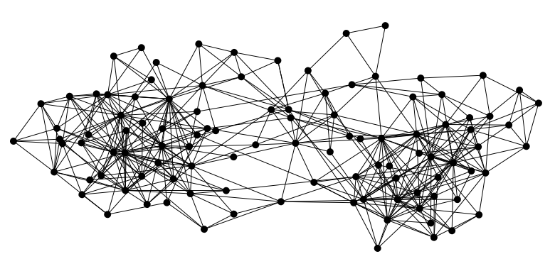

Bitcoin is a peer-to-peer system
When Alice wants to pay Bob: she broadcasts the transaction to all Bitcoin nodes
signed by Alice
Pay to pk_{Bob} : H( )
Note: Bob’s computer is not in the picture

Slide 45
How consensus could work in Bitcoin
At any given time:
All nodes have a sequence of blocks of transactions they’ve reached consensus on
Each node has a set of outstanding transactions it’s heard about

Slide 46



How consensus could work in Bitcoin
Tx
Tx
…
Tx
Tx
Tx
Tx
Tx
Tx
Tx
…
…
…
Consensus
protocol
Tx
Tx
Tx
Tx
Tx
Tx
Tx
…
…
Tx
Tx
OK to select any valid block, even if proposed by only one node

Slide 47
Why consensus is hard
Nodes may crash
Nodes may be malicious
Network is imperfect
Not all pairs of nodes connected
Faults in network
Latency
No notion of global time
Notes:
Analogy of talking on the phone and having a lag

Slide 48
Bitcoin consensus: theory & practice
Bitcoin consensus works better in practice than in theory
Theory is still catching up
BUT theory is important, can help predict unforeseen attacks

Slide 49
Some things Bitcoin does differently
Introduces incentives
Possible only because it’s a currency!
Embraces randomness
Does away with the notion of a specific end-point
Consensus happens over long time scales — about 1 hour

Slide 50
Consensus without identity: the block chain

Slide 51
Why identity?
Pragmatic: some protocols need node IDs
Security: assume less than 50% malicious

Slide 52
Why don’t Bitcoin nodes have identities?
Identity is hard in a P2P system — Sybil attack
Pseudonymity is a goal of Bitcoin

Slide 53
Weaker assumption: select random node
Analogy: lottery or raffle
When tracking & verifying identities is hard, we give people tokens, tickets, etc.
Now we can pick a random ID & select that node

Slide 54
Key idea: implicit consensus
In each round, random node is picked
This node proposes the next block in the chain
Other nodes implicitly accept/reject this block
by either extending it
or ignoring it and extending chain from earlier block
Every block contains hash of the block it extends

Slide 55
Consensus algorithm (simplified)
New transactions are broadcast to all nodes
Each node collects new transactions into a block
In each round a random node gets to broadcast its block
Other nodes accept the block only if all transactions in it are valid (unspent, valid signatures)
Nodes express their acceptance of the block by including its hash in the next block they create

Slide 56
What can a malicious node do?
Double-spending attack
signed by A
C_{A} → B
Pay to pk_{B} : H( )
signed by A
C_{A} → A’
Pay to pk_{A’} : H( )
Honest nodes will extend the longest valid branch
Notes:
Can’t create new transactions from someone else’s address, or modify them.
Suppressing tx’s is only a minor annoyance.

Slide 57
From Bob the merchant’s point of view
1 confirmation
3 confirmations
C_{A} → B
Double-spend probability decreases exponentially with # of confirmations
Most common heuristic: 6 confirmations
C_{A} → A’
double-spend attempt
Hear about C_{A} → B transaction
0 confirmations

Slide 58
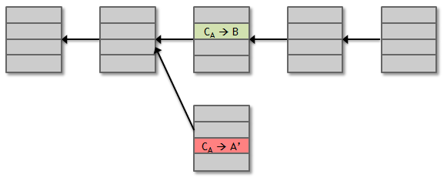
Recap
Protection against invalid transactions is cryptographic, but enforced by consensus
Protection against double-spending is purely by consensus
You’re never 100% sure a transaction is in consensus branch. Guarantee is probabilistic

Slide 59
Incentives and proof of work

Slide 60
Assumption of honesty is problematic
Can we give nodes incentives for behaving honestly?
Everything so far is just a distributed consensus protocol
But now we utilize the fact that the currency has value
Can we reward nodes that created these blocks?
Can we penalize the node that created this block?

Slide 61
Incentive 1: block reward
Creator of block gets to
include special coin-creation transaction in the block
choose recipient address of this transaction
Value is fixed: currently 12.5 BTC, halves every 4 years
Block creator gets to “collect” the reward only if the block ends up on long-term consensus branch!

Slide 62
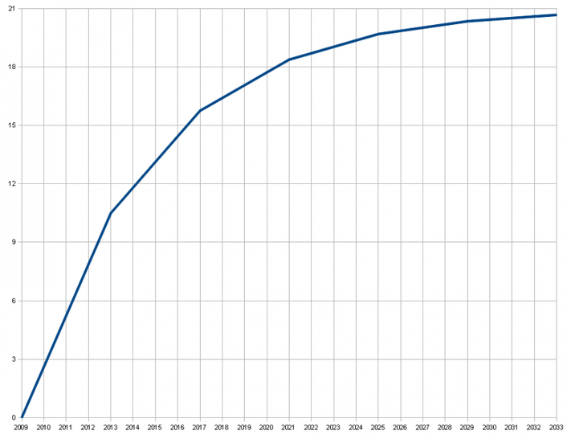
There’s a finite supply of bitcoins
Total supply: 21 million
Block reward is how new bitcoins are created
Runs out in 2040. No new bitcoins unless rules change
Total bitcoins in circulation
First inflection point: reward halved from 50BTC to 25BTC
Year

Slide 63
Incentive 2: transaction fees
Creator of transaction can choose to make
output value less than input value
Remainder is a transaction fee and goes to block creator
Purely voluntary, like a tip

Slide 64
Remaining problems
How to pick a random node?
How to avoid a free-for-all due to rewards?
How to prevent Sybil attacks?

Slide 65
Proof of work
To approximate selecting a random node:
select nodes in proportion to a resource that no one can monopolize (we hope)
In proportion to computing power: proof-of-work
In proportion to ownership: proof-of-stake

Slide 66
Equivalent views of proof of work
Select nodes in proportion to computing power
Let nodes compete for right to create block
Make it moderately hard to create new identities

Slide 67
Hash puzzles
nonce
To create block, find nonce s.t.
H(nonce ‖ prev_hash ‖ tx ‖ … ‖ tx) is very small
prev_h
Tx
Tx
Output space of hash
Target
space
If hash function is secure:
only way to succeed is to try enough nonces until you get lucky
Notes:
If Alice has 100x more computing power than Bob it doesn’t mean she always wins the race. It means she has about a 99% chance of wining. In the long run Bob will create 1% of the blocks

Slide 68
PoW property 1: difficult to compute
As of Aug 2014: about 10²⁰ hashes/block
Only some nodes bother to compete — miners

Slide 69
PoW property 2: parameterizable cost
Nodes automatically re-calculate the target every two weeks
Goal: average time between blocks = 10 minutes
Prob (Alice wins next block) =
fraction of global hash power she controls
Notes:
what happens if time b/w blocks is too low or too high

Slide 70
Key security assumption
Attacks infeasible if majority of miners weighted by hash power follow the protocol

Slide 71
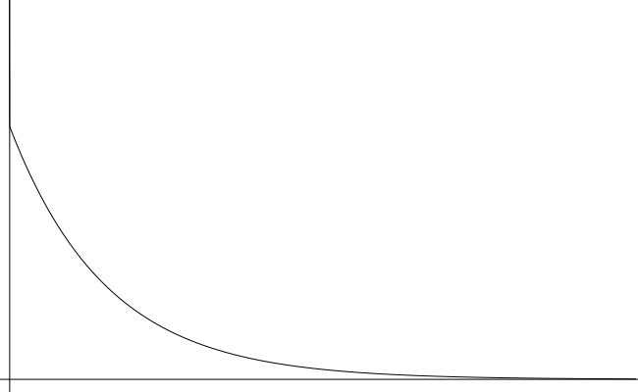
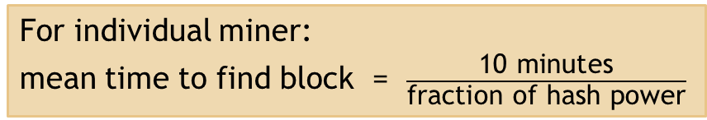
Solving hash puzzles is probabilistic
10
minutes
Probability density
Time to next block (entire network)

Slide 72
PoW property 3: trivial to verify
Nonce must be published as part of block
Other miners simply verify that
H(nonce ‖ prev_hash ‖ tx ‖ … ‖ tx) < target

Slide 73
Mining economics
Complications:
fixed vs. variable costs
reward depends on global hash rate
If mining reward (block reward + Tx fees) | > | hardware + electricity cost | → | Profit

Slide 74
Bitcoin is bootstrapped
security of block chain
health of mining ecosystem
value of currency

Slide 75
What can a “51% attacker” do?
Steal coins from existing address?
Suppress some transactions?
From the block chain
From the P2P network
Change the block reward?
Destroy confidence in Bitcoin?
✗
✓
✗
✗
✓✓

Slide 76
Remaining questions
How do we get from consensus to currency?
What else can we do with consensus?

